Slide 1
Chapter Eight
Recompression Chambers and Therapy

Slide 2
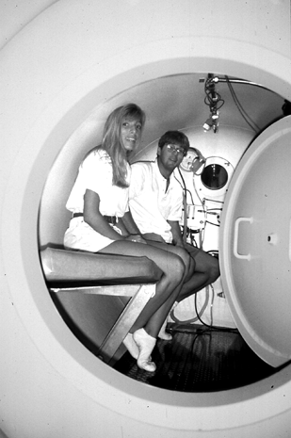
Topics In This Chapter
Why Recompression?
Recompression and Decompression Chambers
Recompression Therapy
Divers, do you know where your chambers are?
Emergency Contact Information

Slide 3
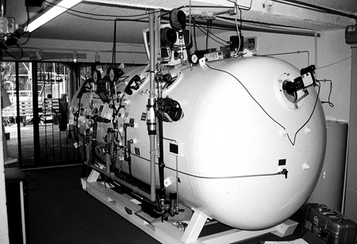
Why Recompression?
Most bubble formation occurs upon ascent
after a dive
Again, shrinks the bubbles
With sufficient pressure, gas bubbles can be forced back into solution, resolving the illness

Slide 4
Recompression and Decompression Chambers
Many hospitals use hyperbaric therapy for
other illnesses and injuries
There is no physical difference between a recompression chamber and a decompression chamber
The only distinction is the application or use of the chamber

Slide 5
Recompression Therapy
Chambers are used to re-pressurize a diver
Diving is simulated by pumping pressurized air into the chamber, increasing the ambient pressure
The pressure is increased until the desired “depth” is achieved
The diver is returned to an equivalent depth, without putting him back in the water
After some time, the diver is slowly returned to surface pressure
Multiple treatments may be required

Slide 6
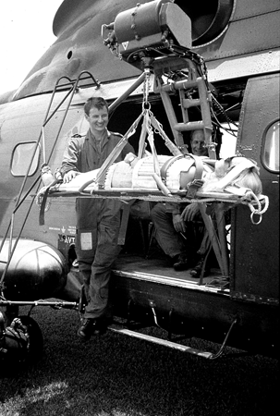
Divers, do you know where your chambers are ?
The rescue does not end on the beach
Rescue divers need to know where to transport the victim for definitive care
Local protocol might require that a diver first be evaluated by a medical facility

Slide 7
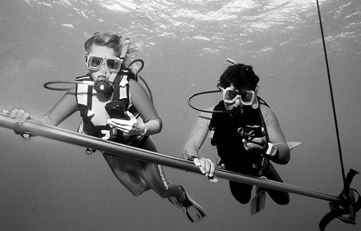
Emergency Contact Information
For this area
Emergency Medical Services
Coast Guard or Marine Police
Divers Alert Network
Local hospital / local chamber

Slide 8
Scuba I.Q. Review

Slide 9
Scuba IQ Review
1
Q
What is the value of recompression in decompression sickness accidents?
A
Subjecting the diver to pressure shrinks the bubbles; with sufficient pressure, gas bubbles can be forced back into solution, resolving the illness

Slide 10
Scuba IQ Review
2
Q
What is the difference between decompression chambers and recompression chambers?
A
The only distinction is the application or use of the chamber

Slide 11
Scuba IQ Review
3
Q
How does a chamber simulate descending to depth?
A
Diving is simulated by pumping pressurized air into the chamber and, thereby increasing the ambient pressure, until the desired “depth” is reached

Slide 12
Scuba IQ Review
4
Q
Do you know where the nearest chamber is to your frequent dive sites?

Slide 13
Any Questions ?

